Slide 1

Applied Data Science Capstone

Slide 2









•
•
•
•
•
•

Slide 3





























































































•
•
•
•
•
•
•
•

Slide 4













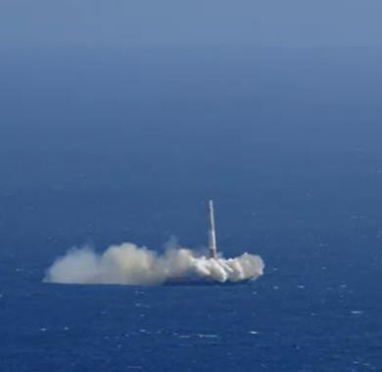















































•
•
•
•
•

Slide 5













Slide 6





































•
•
•
•
•
•
•
•

Slide 7





































































Data Collection Overview

Slide 8








































Data Wrangling

Slide 9















































EDA with Data Visualization

Slide 10


Slide 11

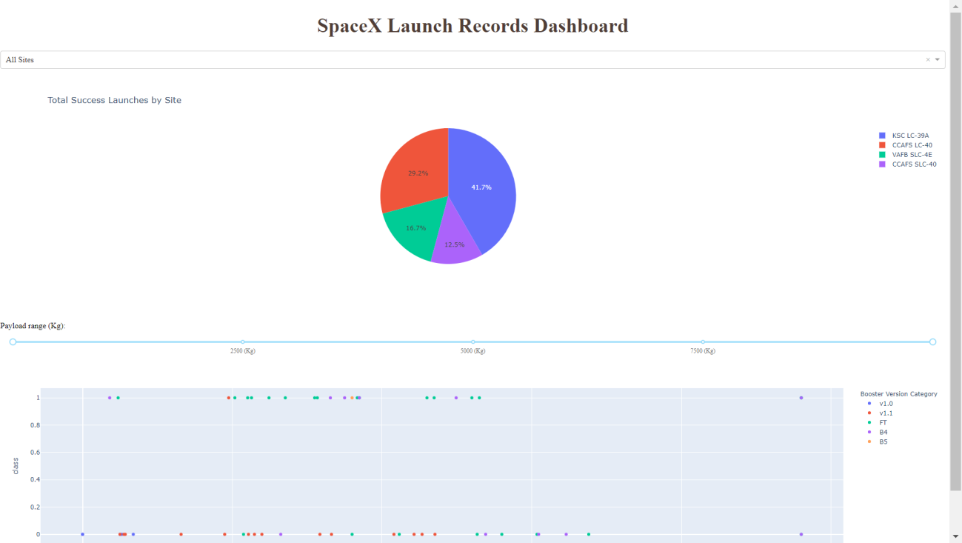
This is a preview of the Plotly dashboard. The following sides will show the results of EDA with visualization, EDA with SQL, Interactive Map with Folium, and finally the resultsof our model with about 83% accuracy.

Slide 12
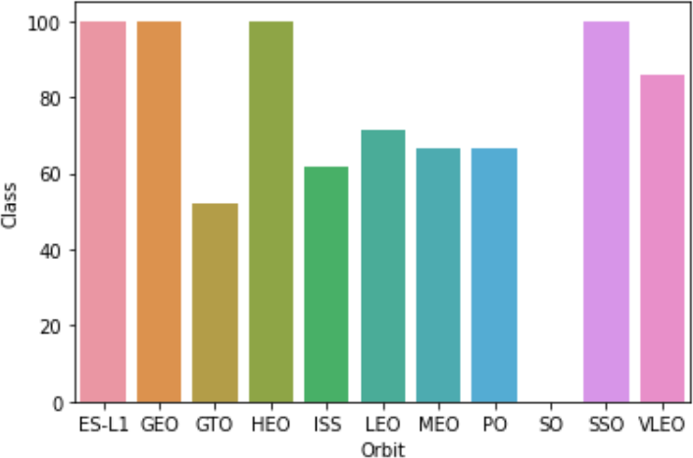
Successrate vs. Orbittype
Success Rate Scale with %
ES-L1 (1), GEO (1), HEO (1) have 100% success rate (sample sizes in parenthesis) SSO (5) has 100% success rate
VLEO (14) has decent success rate and attempts SO (1) has 0% success rate
GTO (27) has the around 50% success rate but largest sample

Slide 13
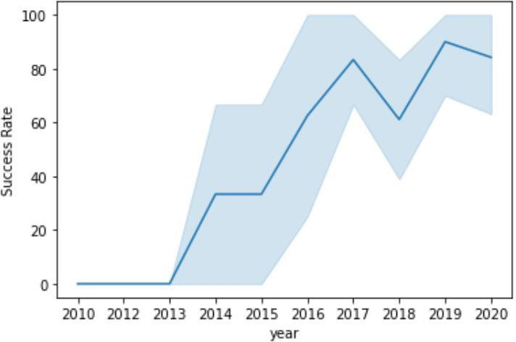
Launch SuccessYearlyTrend
95% confidence interval (light blue shading)
Success generally increases over time since 2013 with a slight dip in 2018 Success in recent years at around 80%

Slide 14
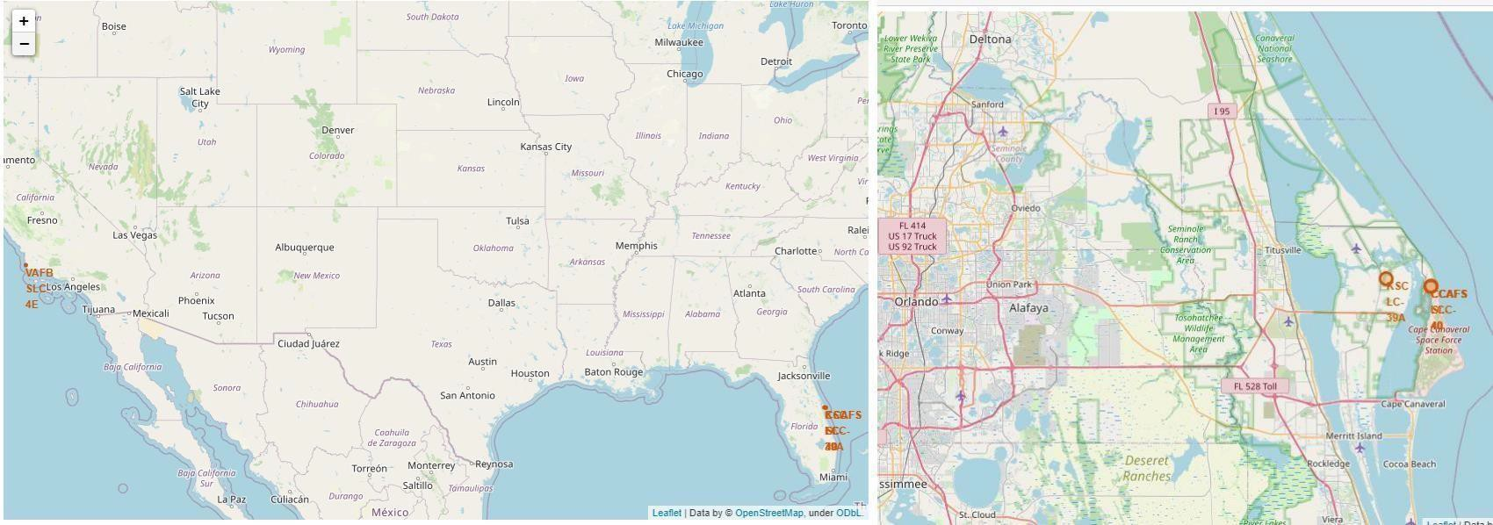
Launch Site Locations
The left map shows all launch sites relative US map. The right map shows the two Florida launch sites since they are very close to each other. All launch sites are near the ocean.

Slide 15
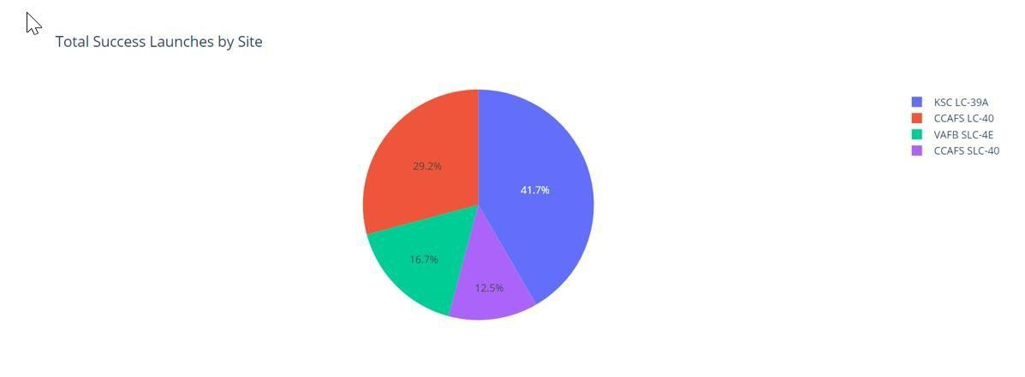

Successful LaunchesAcross Launch Sites
This is the distribution of successful landings across all launch sites. CCAFS LC-40 is the old name of CCAFS SLC-40 so CCAFS and KSC have the same amount of successful landings, but a majority of the successful landings where performed before the name change. VAFB has the smallest share of successful landings. This may be due to smaller sample and increase in difficulty of launching in the westcoast.

Slide 16
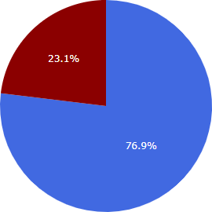

Highest SuccessRateLaunchSite
KSC LC-39A has the highest success rate with 10 successful landings and 3 failed landings.

Slide 17
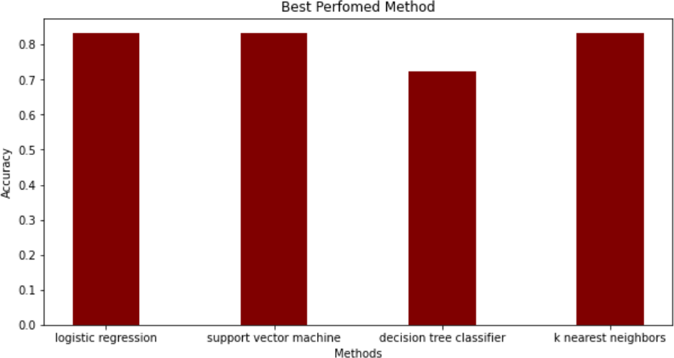
ClassificationAccuracy
The models had virtually the same accuracy on the test set at 83.33%accuracy, except the decision tree classifier with 72,23 %.
It should be noted that test size is small at only sample size of 18.
This can cause large variance in accuracy results, such as those in Decision Tree Classifier model in repeated runs.
We likely need more data to determine the best model.

Slide 18
CONCLUSION
Our task: to develop a machine learning model for Space Y who wants to bid against SpaceX
The goal of model is to predict when Stage 1 will successfully land to save ~$100 million USD
Used data from a public SpaceX API and web scraping SpaceX Wikipedia page
Createddatalabels and storeddata intoa DB2 SQL database
Created a dashboard for visualization
We createda machine learning model with an accuracy of 83%
Allon Mask of SpaceY can use this model to predict with relatively high accuracy whether a launch will have a successful Stage 1 landing beforelaunch to determine whether the launch should be made or not
More data should be collected to better determine the best machine learning model and
improvethe accuracy

